Slide 1
CSAT Analytics Dashboard
Customer Satisfaction Analysis using Power BI
Prepared By
M. Ferdoune
Course
Datamites – Certified Data Analyst (CDA)
JAN -5 Batch
Candidate Unique No:
CA12202596950

Slide 2
Project Objective
Analyze customer support data.
Identify customer behavior and communication trends.
Analyze response time performance.
Improve customer satisfaction.
Generate business insights using Power BI.

Slide 3
Dataset Information
Dataset Name: CSAT Analytics
Total Records: 32,942
Total Columns: 12
Data Source: MySQL Database
Important Features
Customer Name
Sentiment
CSAT Score
Call Timestamp
Reason for Calling
State & City
Communication Channel
Response Time
Call Duration
Call Center

Slide 4
Tools And Technologies Used
Technologies
Power BI
MySQL Database
Concepts Used
Data Visualization
Dashboard Analytics
KPI Analysis
Business Intelligence
Interactive Reporting

Slide 5
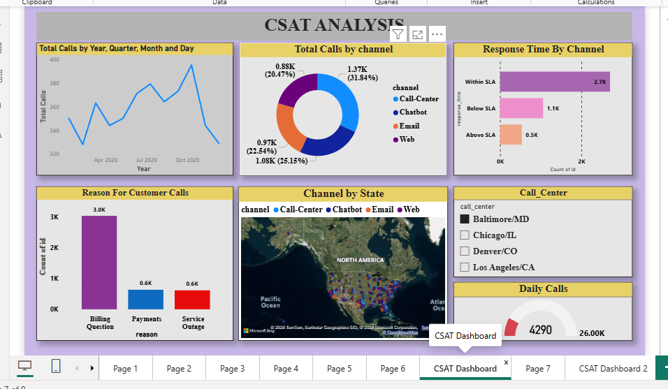
Dashboard Visualization

Slide 6
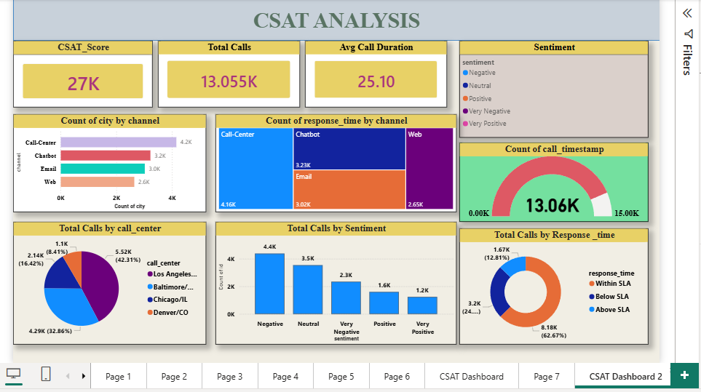

Slide 7
Dashboard Includes:
KPI Cards
Call Trends Analysis
Channel Analysis
Response Time Analysis
Sentiment Analysis
State-wise Analysis
Interactive Filters

Slide 8
Key Insights
The call centre is the most frequently used communication channel.
Most customer calls were handled within SLA response time.
Billing-related issues generated the highest customer call volume.
Customer interactions vary across states and channels.
Positive and neutral sentiments contribute significantly to customer interactions.
Customer support demand fluctuates over different periods.

Slide 9
Suggestions & Recommendations
Improve billing support services to reduce complaints.
Maintain SLA performance to improve customer satisfaction.
Enhance chatbot and email support systems.
Allocate additional support resources during peak periods.
Focus on high-interaction regions for operational improvement.

Slide 10
Conclusion
The CSAT Analytics Dashboard successfully analyzed customer support data.
The project helped identify customer behavior, response performance, and communication trends.
Power BI visualizations provided meaningful business insights.
The analysis can help improve customer satisfaction and operational efficiency.

Slide 11
THANK YOU

